Slide 1
Auditing Distance
Michele Deering-Volz
Maxime Dubuc
Carl Robinson

Slide 2
The Key to
Efficient and Effective Auditing
starts with…
Risk Assessment

Slide 3
Auditors will not detect a material misstatement, inconsistency, or significant error -

Slide 4
What risks do we have?
How do we reduce this risk?
Notes:
Based on our audit objectives, Whether all distance is being recorded, whether the recorded distance is accurately allocated
will determine the amount of testing that needs to be performed on the carrier's recordkeeping system.

Slide 5
Knowing how distance is recorded
Increases the effectiveness of the tests performed
Determines amount of testing
Notes:
To reduce this risk, the auditor needs to know how the distance is recorded. Having a clear understanding increases the accuracy and efficiency of the tests an auditor performs.

Slide 6
How is distance recorded?
Driven by
Section 395 of Federal regulations
Hours-of-Service (HOS)
Purpose is for safety on the roadways

Slide 7
Section 395
Strict limits on when and how long a driver can operate a commercial vehicle
Requires running log of time on duty

Slide 8
Two methods -
Manually - Driver's Daily Logs (DDLs)
Electronically (EOBR)

Slide 9
Logbook requirements –
Very specific
Can be inspected at any time
Must include:
a 24 hour grid,

Slide 10
Date
Vehicle #
Driver’s Name
Total distance

Slide 11
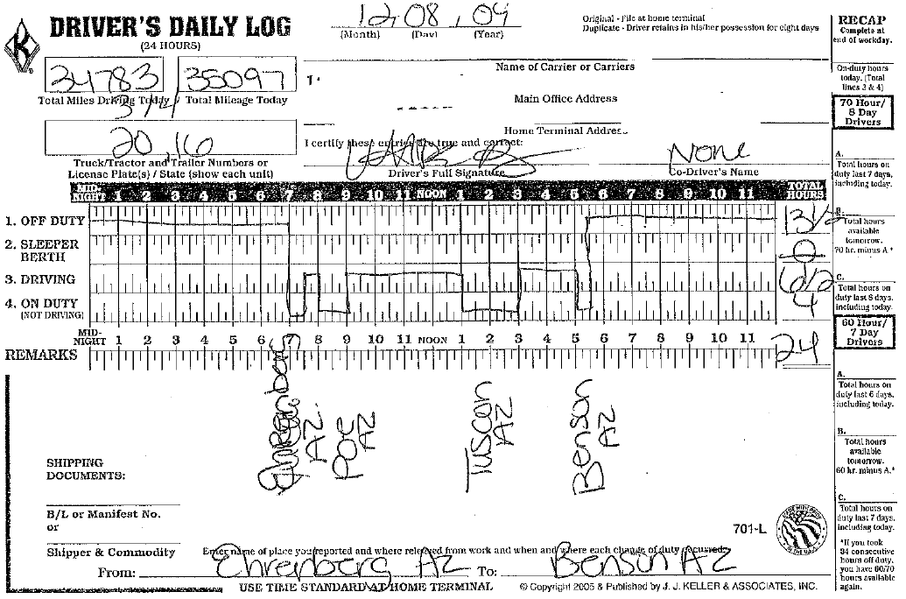
Total hours for each duty status
Origination and destination

Slide 12
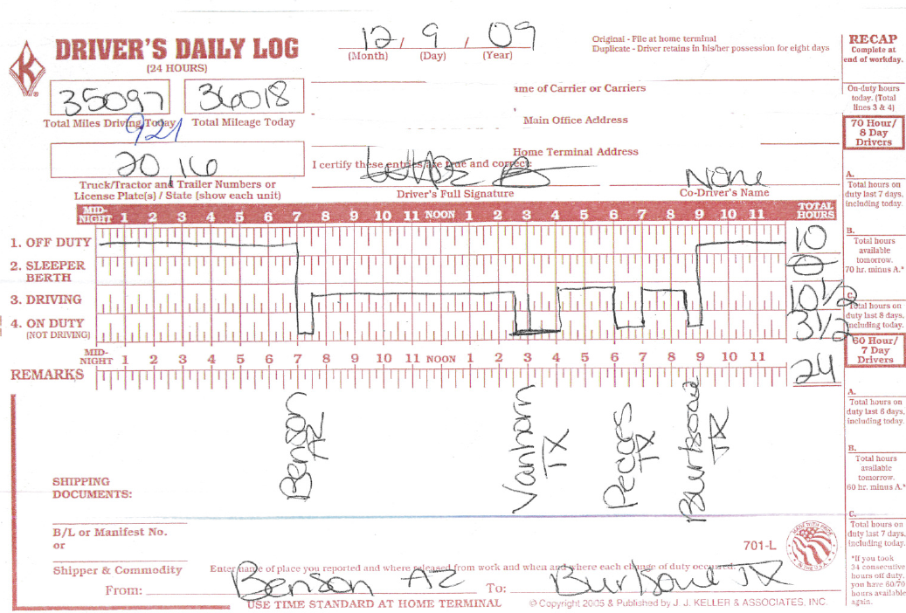
Location of each duty status change,
city and state
Notes:
To reduce this risk, the auditor needs to know how the distance is recorded. Having a clear understanding increases the accuracy and efficiency of the tests an auditor performs.

Slide 13
In general DDLs can only verify whether all distance is recorded…
do not show distance by jurisdiction
From an audit perspective are not considered adequate records by themselves.

Slide 14
So why is this information relevant?
Notes:
One of our audit objectives is to determine if all distance is recorded and the accuracy of the recorded distance. Because violations to the HOS rules can result in fines &/or being placed out of service, the importance of accurately recording distance is significant. This is not to say that all distance is always accurately recorded, but the risk of material misstatement is greatly reduced.

Slide 15
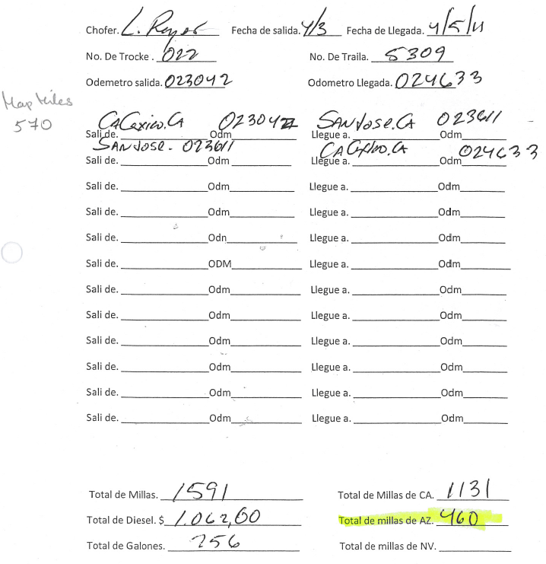
Per distance software
1140 CA miles

Slide 16
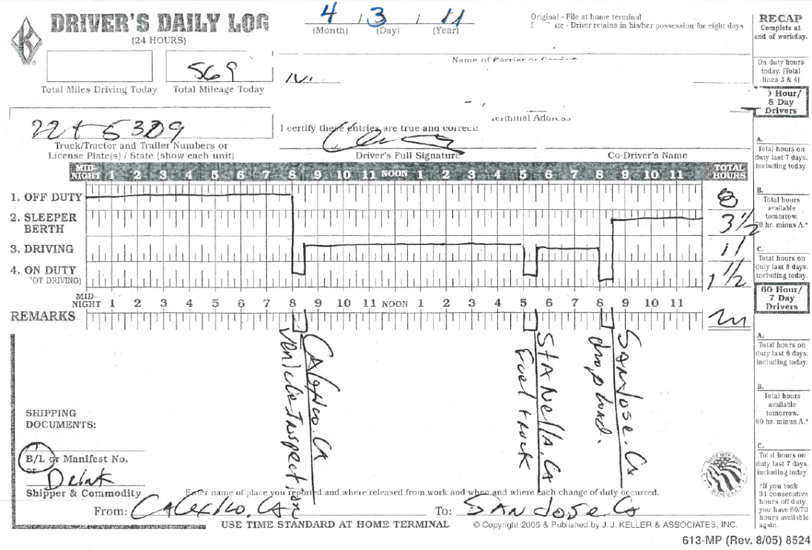

Slide 17
Testing of Source Documents
Verifying recorded information
Unexplained differences
Error Rate Calculations
Notes:
time lapses between trips, material differences between distance software and recorded distance, etc.
If the auditor understands how distance is recorded, the cause of the differences can be determined, thereby increasing the accuracy of test results and error rate calculations

Slide 18
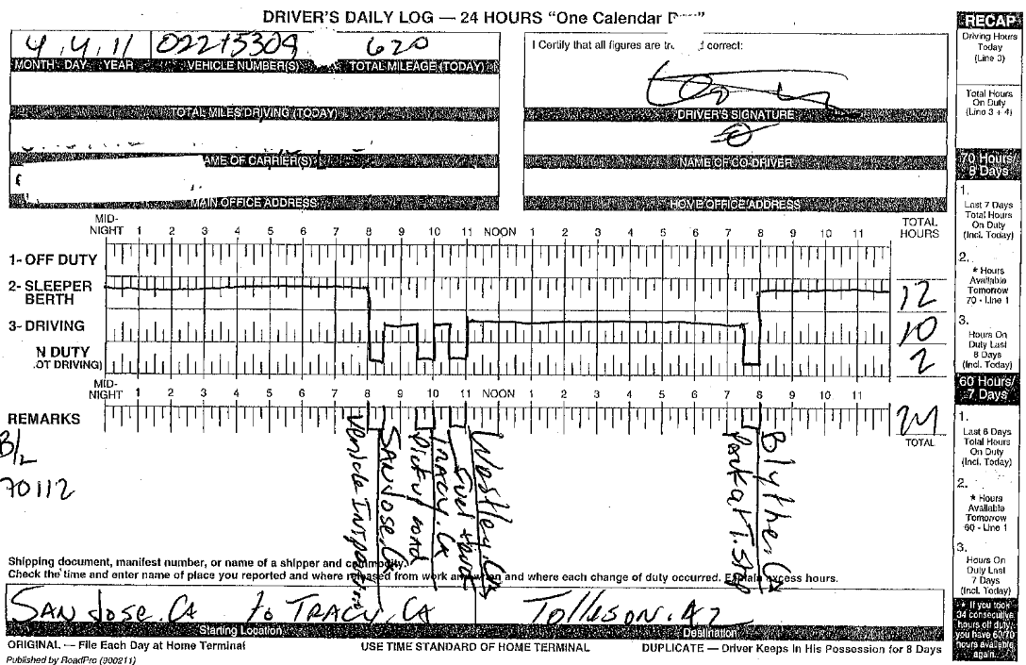

Slide 19
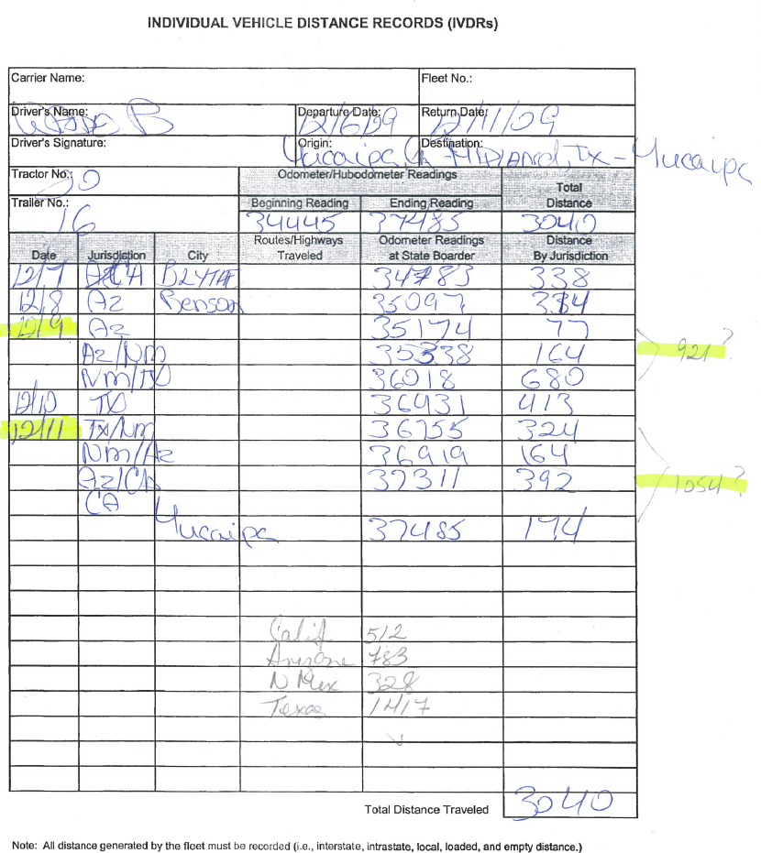
Notes:
Are these readings accurate, or is the carrier backing into the readings

Slide 20
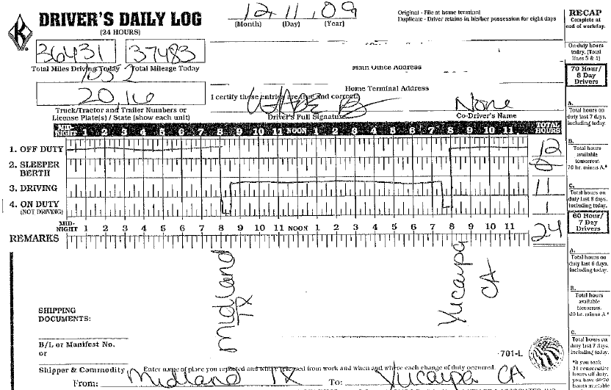
Notes:
How can a vehicle travel 1052 miles in one day?

Slide 21
GPS Based Mileage Reporting

Slide 22
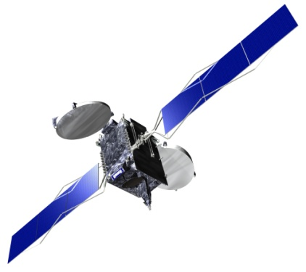
Global Positioning System (GPS)
Definition:
A system of satellites, computers, and receivers that is able to determine the latitude and longitude of a receiver on Earth by calculating the time difference for signals from different satellites to reach the receiver.

Slide 23
GPS Trends In Trucking
Early 1990s: Many large truck load fleets adopted onboard computers to message with and track their vehicles via satellite communication. GPS locations (pings) were typically recorded hourly in addition to each time the truck sent or received a message.
Mid 1990s: GPS began to be used to calculate miles traveled.
Early 2000s: Use of on-board computers expanded as cellular networks allowed for more inexpensive communications. GPS ping granularity increased as did integration into the tractor’s Engine Control Module (ECM).
2010: Federal Motor Carrier Association proposed a mandate of Electronic Onboard Recorders (EOBRs) for purposes of tracking driver Hours of Service.

Slide 24
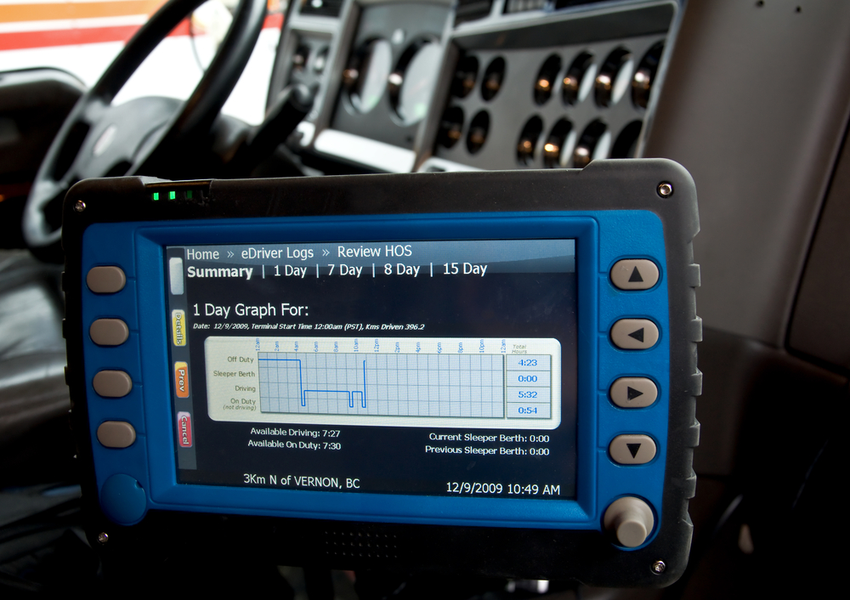
Electronic Onboard Recorders (EOBR)

Slide 25
EOBR Mandate
Federal Motor Carrier Association (FMCSA) is considering a proposed rule to mandate the use of EOBRs. The rule would require the use of a proven technology for accurately capturing driving time and increasing the level of compliance with the hours of service (HOS) rules. EOBRs must contain GPS tracking in order to be compliant.

Slide 26
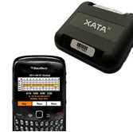
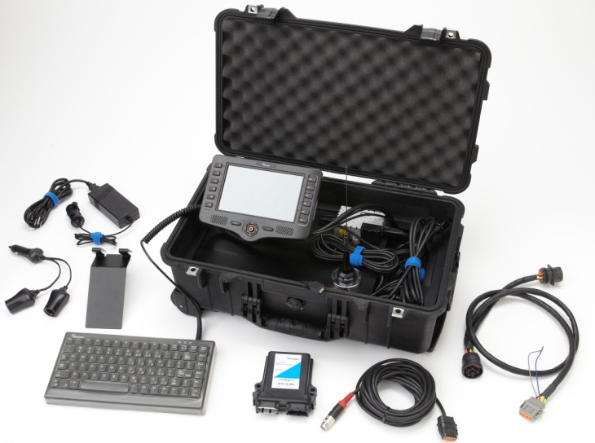
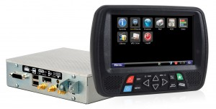
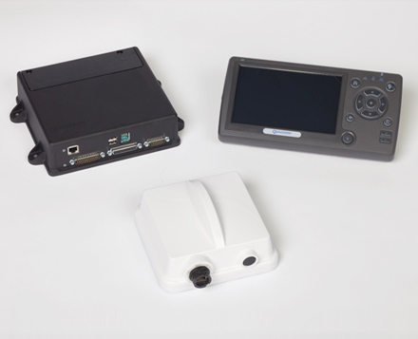
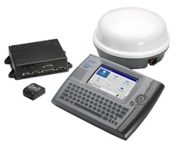
EOBRs

Slide 27
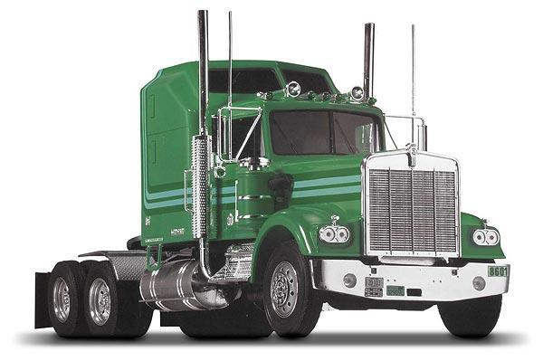
Global Positioning System (GPS)

Slide 28
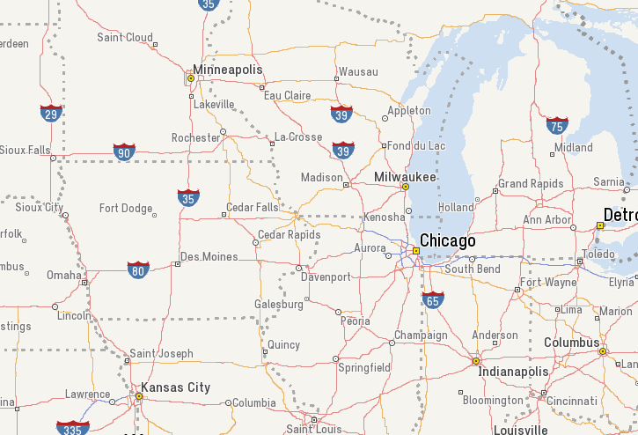
Using GPS to Calculate Distance Traveled

Slide 29
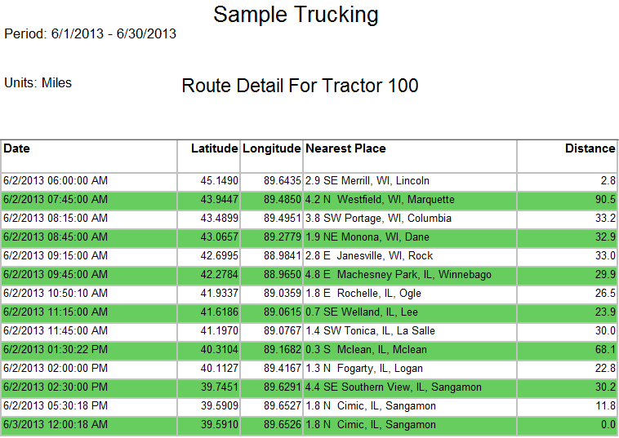
Using GPS to Calculate Distance Traveled

Slide 30
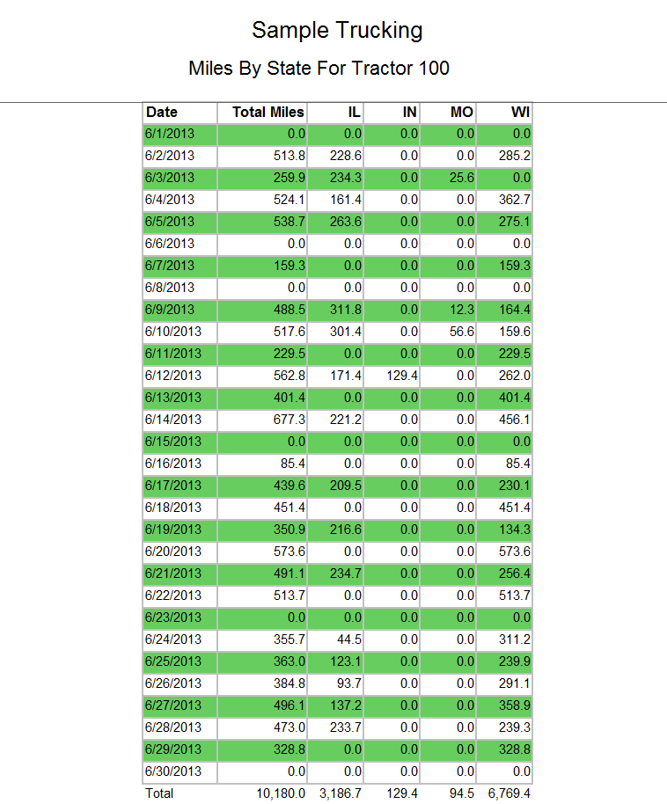

Slide 31
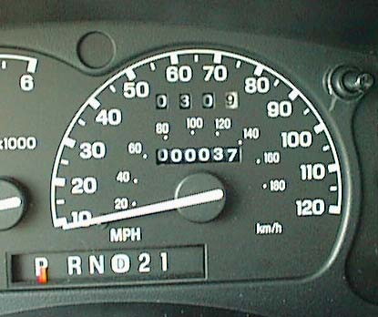
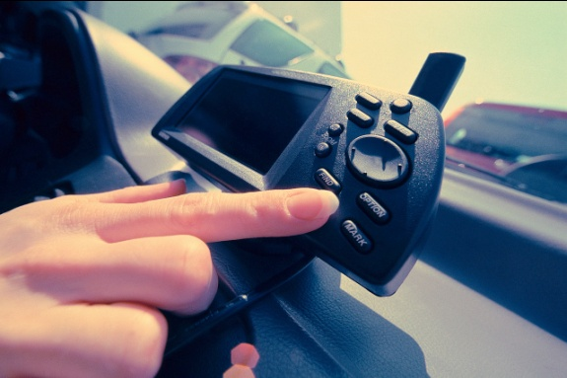
Odometer Readings vs GPS
Odometers are a mechanical measure
Count tire rotations
Can be captured in a variety of manners
Electronically by ECM
Hand entered by driver at fuel stops
Hand written by driver on paper
Susceptible to wear and tear / breakdowns
Can be mis-calibrated (adjustment and/or tire size)
GPS readings
Ping frequency can affect accuracy
Missing GPS data (gaps) causes errors
“Bad” pings happen
Mileage programs differ in interpreting GPS data
(ALK’s PC*Miler, Rand McNally, ProMiles, etc)

Slide 32
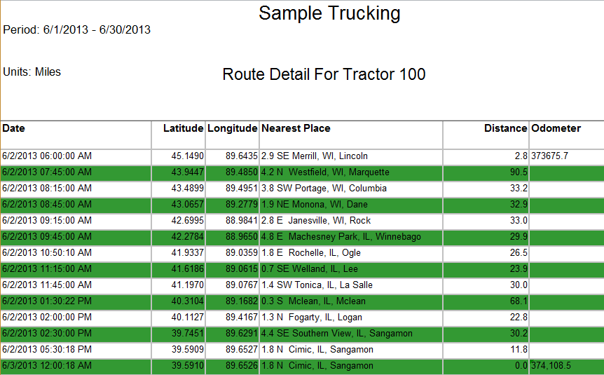

Slide 33
Using Geofencing

Slide 34
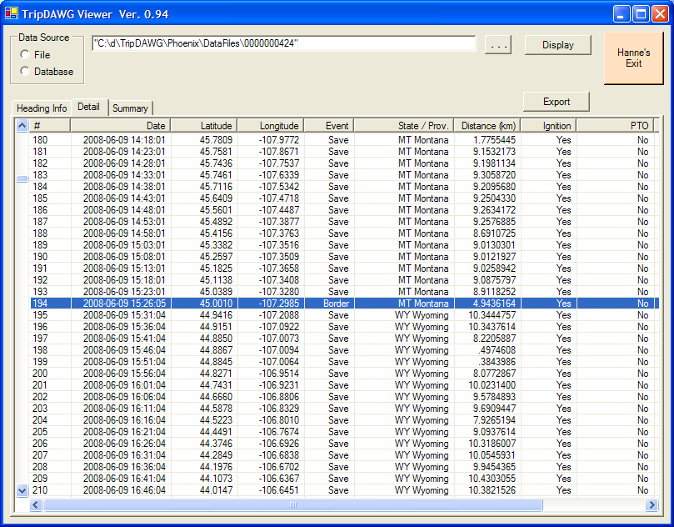
Sample data

Slide 35
Summary Report

Slide 36
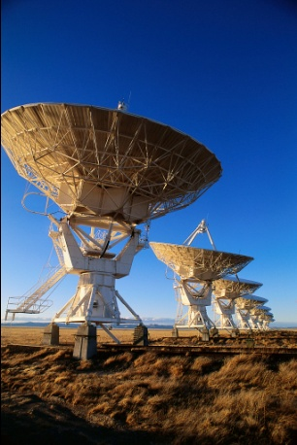
GPS Ping Frequency
What ping frequency is required to ensure accuracy? Several factors influence ping frequency.
2. Length of Trip
Longer trips require less frequent pings
One hour pings seem to work fine on average trip lengths over 200 miles
Short-haul and local distribution fleets require more frequent pings – 15 minutes recommended
3. Pings at loading and unloading points reduce the need for high ping frequency
Empty and ready status messages peg destinations
Loaded and departing status messages peg origins

Slide 37
Recommendations for GPS Audits
1. Remain flexible when testing against odometer reading
Remember odometer readings are not perfect
Carefully evaluate the source of odometer readings; drivers often “guess” or “round” readings
2. Remember that as newer GPS systems become more widespread, (with odometer readings for each GPS ping) automated normalization will become the standard

Slide 38
Auditing Distance

Slide 39
How the GPS Carriers Work
What do we need as an auditor to do the audit?

Slide 40
Documents and Reports
What documents and reports are required to conduct an audit with GPS?
( Summary by unit , place of departure / arrival , odometer reading start / end by quarter, month, ... , exception report , recording points) ...
What can be printed?

Slide 41
How do you record odometer reading?
Manual input ( driver )
Automatically among the ECM
Reading odometer when maintenance repairs

Slide 42
Distance
At which frequency does the system save recording points?
What is the method used to calculate the distances?
How do you distribute miles by jurisdiction?

Slide 43
Exception Reports
Are they treated?
How are they treated?

Slide 44
Modification
Do you have any GPS data being modified?
What do you modify and why?

Slide 45
Security Measure
Internal controls that the software offers
How to prevent altering of information?

Slide 46
Recognize Differences and Make Adjustments

Slide 47
Source Differences
Human error
(wrong input odometer reading, system installed incorrectly, error in processing computer data, didn’t correct exception reports)
Material error
(break module, loss of communication satellite/module)

Slide 48
Possible Gap
Error reading recording points
Exception report
No odometer available
No distance stated in a jurisdiction where fuel was purchased

Slide 49
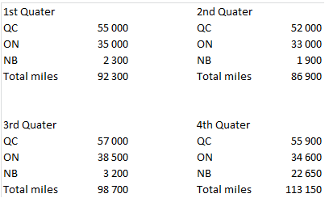
Major Difference Between Statements

Slide 50
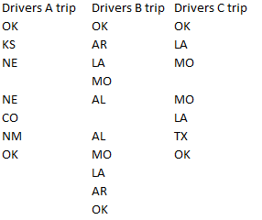
Inconsistency Followed Jurisdiction

Slide 51
How to Adjust a Missing Trip
We found a fuel receipt for a unit where no distance was stated.
After analyzing, it's a missing trip.
Logbook available for that missing trip.
Use city on the logbook and build trip on a distance software

Slide 52
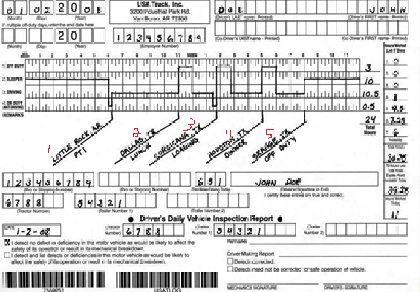
How to Adjust a Missing Trip
Name | Address | City,State | Zip Code | Country

Slide 53
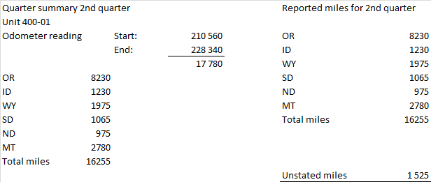
Inconsistency in Miles Declared and Odometer Total

Slide 54
Adjusting the Discrepancies
Can we project the discrepancies?
How can we adjust the gap?
( using data from previous trip, use of software that calculates distances…)

Slide 55
Projectable Gap
The company use two drivers. They do the same trip.
Drivers B always follow drivers A.
Reported miles by drivers
Drivers A |  | Drivers B |  |  | Difference
IA | 175 | IA | 174 |  | -1
IL | 325 | IL | 290 |  | -35
KY | 110 | KY | 109 |  | -1
KY | 105 | KY | 106 |  | 1
IL | 330 | IL | 295 |  | -35
IA | 190 | IA | 191 |  | 1
Total | 1235 |  | 1165 |  | -70
Starting odometer | 655780 |  | 867 984
Ending odometer | 657015 |  | 869 219
Total | 1235 |  | 1 235 |  | 0

Slide 56
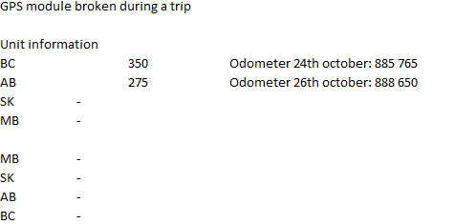
Non-projectable Gap

